Slide 1
Literature of the 18th Century

Slide 2
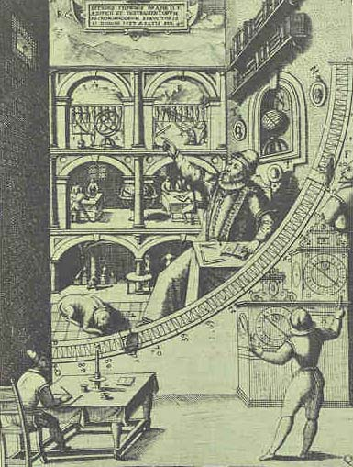
The 18th Century
Age of Enlightenment
Age of Reason
⇩
use reason + advance
knowledge through
scientific method
⇩
reform society

Slide 3
The 18th Century
⇩
Neoclassicism
⇩
Romanticism, late 18th century

Slide 4
Literature of the 18th Century
⇩
French Literature
English Literature
American Literature

Slide 5
French Literature
⇩
salon, café
⇩
cultural hub
⇩
centre of intellectual, social exchange

Slide 6
an intellectual meeting in the salon of Mme. Geoffrin

Slide 7
Voltaire and Diderot at the Café Procope

Slide 8
Café Procope (Le Procope) at present

Slide 9
French Literature
⇩
Denis Diderot
Jean le Rond D’ Alembert

Encyclopédie / Encyclopedia
⇩
philosophes + encyclopédistes:
Voltaire, Rousseau, Montesquieu

Slide 10
French Literature
⇩
René Descartes
⇩
Father of Modern Philosophy

Passions of the Soul
The Description of the Human Body
⇩
human body works like a machine
mind controls the body

Slide 11
French Literature
⇩
Montesquieu

Lettres Persannes
(Persian Letters)
⇩
a satire based on the imaginary correspondence of a Persian visitor to Paris
⇩
pointing out the absurdities of French society

Slide 12
French Literature
⇩
Montesquieu

De L’Esprit des Lois
(The Spirit of the Laws)
⇩
a treatise on political theory
⇩
enormous influence in Europe

Slide 13
French Literature
⇩
François-Marie Arouet
Voltaire

almost every litreary form: plays, poem, novels, essays, historical and scientific works
⇩
his best-known novel
⇩
Candide

Slide 14
Candide

Slide 15
French Literature
⇩
Jean-Jacques Rousseau

Discourse on the Origin of Inequality
The Social Contract
⇩
inspired political reforms or revolutions in America and France
⇩
influenced the romantic movement in the latter part of the 18th century

Slide 16
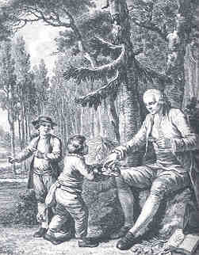

Slide 17
English Literature
⇩
1. Poetry
2. Prose

Slide 18
English leading poets and writers of the 18th Century

Slide 19
Poetry
⇩
Alexander Pope

The Rape of the Lock
Dunciad
⇩
satirical verse

Homer’s Illiad, Odyssey

Slide 20
Poetry
⇩
latter part of 18th century
⇩
Pre-Romanticists
⇩
Thomas Gray
Robert Burns
William Blake

Slide 21
Poetry: Pre-Romanticist
⇩
Thomas Gray

Elegy Written in a Country Churchyard

Phraya Anuman Rajadhon,
Phraya Upakit Silapasan
⇩
รำพึงในป่าช้า

Slide 22
St. Giles’ Church at Stoke Poges Village where Gray wrote his Elegy Written in a Country Churchyard

Slide 23
Poetry: Pre-Romanticist
⇩
Robert Burns

A Red, Red Rose
Scots Wha Hae
⇩
unofficial national anthem of Scotland

Auld Lang Syne
⇩
Chao Phraya Thammasak Montri

Samakkee Chumnum

Slide 24
Poetry: Pre-Romanticist
⇩
William Blake

Songs of Innocence
Songs of Experience

Slide 25
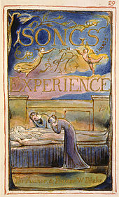
William Blake

Slide 26
Prose
⇩
rise of modern novels
⇩
Jonathan Swift

Gulliver’s Travels
⇩
weapon to satire on human nature

Slide 27
Novel  Gulliver’s Travels 
Lamuel Gulliver ⇨ adventures
⇩
the land of Lilliput
the land of the Brobdignag
the flying island of Laputa
the country of Houyhnhnms

Slide 28
Gulliver in the land of the Lilliput

Slide 29
Gulliver in the land of the Brobdignag

Slide 30
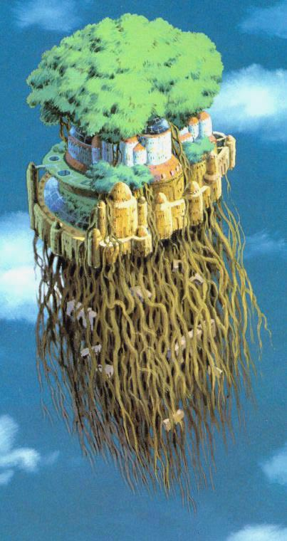
Gulliver watching the flying island of Laputa

Slide 31
Gulliver on the flying island of Laputa

Slide 32
Gulliver leaving the land of the Houyhnhnms

Slide 33
Novel
⇩
Daniel Defoe

Robinson Crusoe
⇩
adventures of Robinson Crusoe
⇩
an island, the Pacific

Slide 34
Crusoe rescuing Friday from the cannibals

Slide 35
Novel
⇩
Samuel Richardson

Pamela; or The Virtue Rewarded
⇩
one of the first realistic novels

Slide 36
Novel
⇩
Henry Fielding

Tom Jones
⇩
one of the greatest novels ever written
⇩
characters from all walks of life,
not typical knights of chivalric romance

Slide 37
American Literature
⇩
Puritan faith declicned
⇩
American enlightenment
⇩
political leaders were not religious leaders
⇩
Deism / Deists
⇩
belief in God as the creator with no reference to the Bible or other miraculous sources

Slide 38
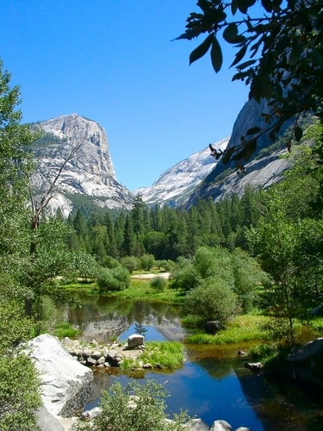
Deism / Deist
a natural religion
- belief in the greatness
of nature

Slide 39
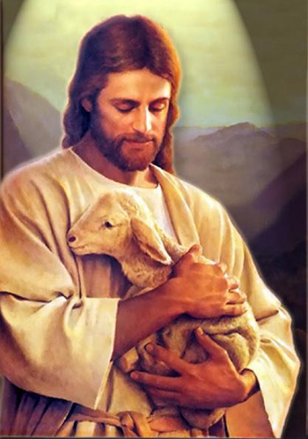
Deism / Deist
belief in the existence
of God as the creator
belief in Jesus as a man,
not a divine god

Slide 40
American Enlightenment
⇩
rationalism, scientific inquiry,
representative government
⇩
natural rights of man
⇩
justice, liberty, equality

Slide 41
American literature
⇩
Poetry
Prose

Slide 42
Prose
⇩
focus on rationalism

Benjamin Franklin
Thomas Jefferson

Slide 43
Benjamin Franklin in the Court of Louis XVI of France

Slide 44
Prose
⇩
Benjamin Franklin
⇩
America’ s first great man of letters
⇩
writer, printer, publisher, scientist, philanthropist, diplomat

Slide 45
Prose
Benjamin Franklin
⇩
self-educated, first great self-made man
in America

Autobiography
⇩
record of his life and success

Slide 46
Prose
Benjamin Franklin

Poor Richard’s Almanack
⇩
encouragement, advice, factual information
⇩
memorable sayings of Father Abraham,
Poor Richard
⇩
“God helps them that help themselves.”

Slide 47
Prose
⇩
Thomas Jefferson

Declaration of Independence (1776)
⇩
Independence Day
⇩
The Fourth of July

Slide 48
The Declaration of Independence

Slide 49
Poetry
⇩
a weapon during the American Revolution
⇩
the use of verses and songs to celebrate
their heroes
⇩
Yankee Doodle

Slide 50
Poetry
⇩
Philip Freneau
⇩
the most memorable American poet
of this period

Slide 51
Philip Freneau
⇩
American Pre-Romanticist

Romantic lyrics of real grace and feeling
in the American scene
⇩
On the Uniformity and Perfection of Nature
On the Religion of Nature
The Indian Student or, Force of Nature,
The Indian Burying Ground

