Slide 1
Literature of the 19th Century

Slide 2
Literature of the 19th Century
first part of the 19th century
⇩
Romanticism
second part of the 19th century
⇩
Realism

Slide 3
First Part of the 19th Century  Romanticism

Slide 4
Romanticism
⇩
spread throughout Europe
⇩
reaction to 18th-century rationalism

Slide 5
Romanticism
⇩
revolt against social and political norms of the
Age of Enlightenment
- reaction against the scientific rationalization of nature
- appreciation of the beauties of nature
- praise of emotion over reason
- praise of the senses over intellect

Slide 6
Romanticism
⇩
Founders of Romantic Movement in England
⇩
William Wordsworth
Samuel Taylor Coleridge

Lyrical Ballads (1789)

Slide 7
Poetry
⇩
William Wordsworth
Samuel Taylor Coleridge
⇩
Lake Poets
⇩
launch the Romantic Age in English literature

Slide 8
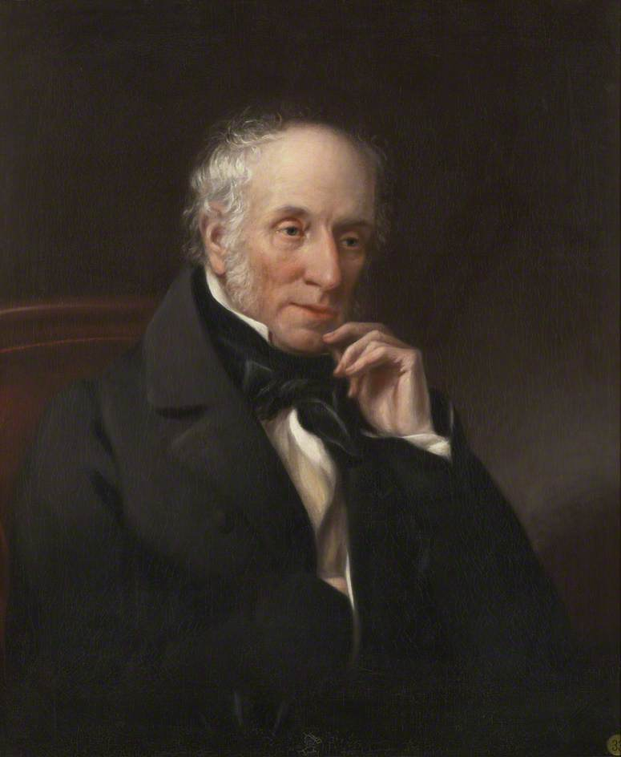
William Wordsworth
deeply influenced by
the love of nature,
the sights and scenes
of Lake Country

Slide 9
William Wordsworth

To Daisy
She Dwelt among the Untrodden Ways
I Wandered Lonely as a Cloud
⇩
tenderness and a love of simplicity

Slide 10
tenderness and a love of simplicity seen in Wordsworth’s poems

Slide 11
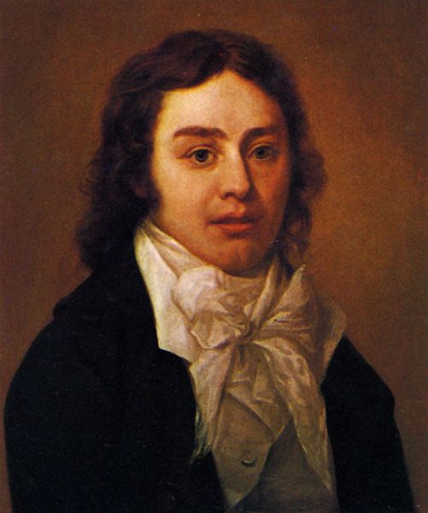
Samuel Taylor Coleridge
- Rime of the Ancient
Mariner
- Kubla Khan

Slide 12
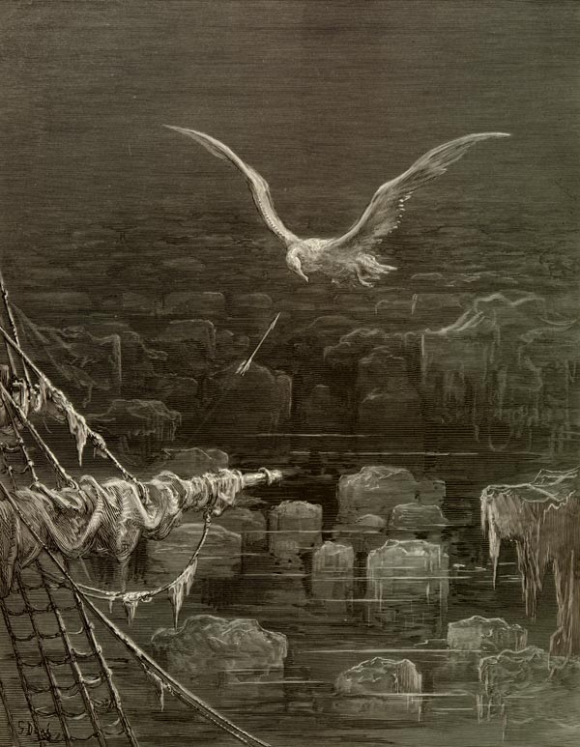
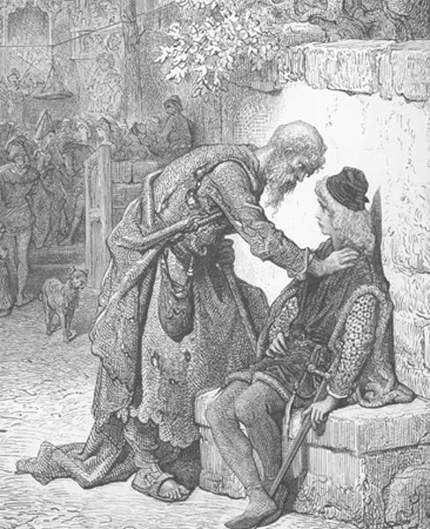
Rime of the Ancient Mariner: an old mariner was fated because he destroyed nature represented by an albatross

Slide 13
Prose
⇩
great increase of novels
⇩
the extent of the novel-reading public

Slide 14
Prose
⇩
Gothic romance
⇩
Sir Walter Scott

Ivanhoe
The Talisman

Slide 15
Sir Walter Scott
⇩
feeling of nostalgia ⇨ romantic
⇩
thrilling adventures, beautiful and distressed ladies, brave and handsome heroes in the scenes of a bygone age
⇩
England in the past during the Medieval

Slide 16
Prose
⇩
novel
⇩
Jane Austen
⇩
one of the most memorable novelist

Slide 17
Jane Austen

Slide 18
Jane Austen
⇩
novels
⇩
reflect English middle-class life in small communities more perfectly and realistically than had ever been done before
⇩
social commentary

Slide 19
Jane Austen
⇩
novels

Sense and Sensibility
Pride and Prejudice
Mansfield Park
Emma
Northanger Abbey
Persuasion

Slide 20
French Literature
⇩
Alexandre Dumas, père
Victor Hugo

Slide 21
Prose
⇩
novels
⇩
Alexandre Dumas, père

The Count of Monte Cristo
The Three Musketeers
⇩
translated into 100 languages
adapted for nearly 200 films

Slide 22
The Three Musketeers

Slide 23
Prose
⇩
novels
⇩
Victor Hugo
⇩
romantic poet, novelist, dramatist
⇩
greatest, best known French romanticist

Slide 24
Victor Hugo
novels
⇩
Les Misérables
Notre-Dame de Paris
or
The Hunchback of Notre-Dame

Slide 25
The Hunchback of Notre-Dame

Slide 26
Les Misérables

Slide 27
American Literature
⇩
American writers
⇩
create a distinctive American literature

Slide 28
Prose
⇩
Washington Irving
⇩
the first prominent American author
of short tales
⇩
America’ s first genuine man of letters

Slide 29
Washington Irving

short tales
⇩
Rip Van Winkle
The Legend of Sleepy Hollow

Slide 30
Washington Irving
⇩
Rip Van Winkle
⇩
the story of a man who slept through the American Revolutionary War
⇩
after drinking the liquor of the ghosts of
Hendrick /Henry Hudson’s crew

Slide 31
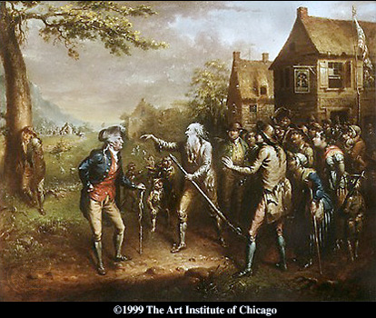
Rip Van Winkle

Slide 32
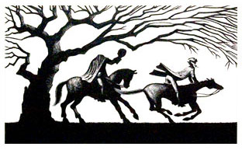
Legend of the Sleepy Hollow

Slide 33
Prose
⇩
James Fenimore Cooper

novel
⇩
first important American novelist to use American subjects and setting

Slide 34
Novel
⇩
James Fenimore Cooper

The Spy
⇩
a tale of the American Revoluiton

Slide 35
Novel
⇩
James Fenimore Cooper

Leatherstocking Tales
⇩
The Pioneer
The Last of the Mohicans
The Prairie
The Pathfinder
The Deerslayer

Slide 36
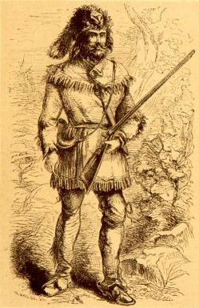
James Fenimore Cooper
Natty Bumpo , hero
of the Leatherstocking
Tales

Slide 37
Prose
⇩
short story
⇩
Nathaniel Hawthorne

Twice-Told Tales
⇩
Young Goodman Brown

Slide 38
Nathaniel Hawthorne

novel
⇩
Scarlet Letter
⇩
symbolic romance, set in a historical setting of
Puritan New England
⇩
Hester Prynne, a young woman found guilty of adultery ⇨ is required to wear a scarlet "A“ (the symbol of “adultery”)
on her dress
⇩
Hawthorne’s masterpiece

Slide 39
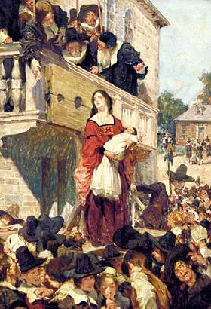
Nathaniel Hawthorne
mysterious setting
of Puritan society
in The Scarlet Letter

Slide 40
Edgar Allan Poe
⇩
writer, poet, editor, literary critic
⇩
best-known for tales of mystery

Slide 41
Poetry
⇩
Edgar Allan Poe

City in the Sea
Lenore

Slide 42
Prose
⇩
short story

The Fall of the House of Usher
The Tell-Tale Heart
⇩
tales of Gothic horror

Slide 43
Transcendentalism
⇩
society and its institutions corrupt the purity
of the individual
⇩
people are at their best when truly "self-reliant" and in harmony with nature

Slide 44
Literary Works of the Transcendentalists
⇩
Ralph Waldo Emerson
⇩
leader of the Transcendentalists

Nature
⇩
formed a movement known as Transcendentalism

Slide 45
Literary Works of the Transcendentalists
⇩
Henry David Thoreau
⇩
most gifted follower of Emerson

Walden
⇩
records Thoreau’s two-years experience in the wood where he lived mostly by himself in a cabin
by a pond called Walden

Slide 46
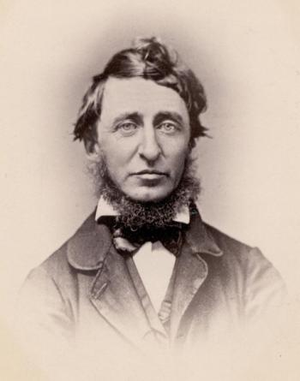
Henry David Thoreau 

Slide 47
Literary Works of the Transcendentalists
⇩
Henry David Thoreau

Resistance to Civil Disobedience
⇩
inspired modern thinkers ⇨ Mahatama Gandhi
⇩
to use the nonviolent resistance against
the injustice

Slide 48
Gandhi was impressed by Henry David Thoreau’s advice to resist things that were wrong or injustice by refusing to cooperate.

Slide 49
Second Part of the 19th century  Realism
⇩
mid 19th century
⇩
writers and artists
⇩
reject the emotional expression of the Romanticists
⇩
depict things accurately and realistically

Slide 50
French Literature
⇩
depicts contemporary life realistically
⇩
Honoré de Balzac
Gustave Flaubert

Slide 51
Prose
⇩
Gustave Flaubert

Novel
⇩
Madame Bovary
⇩
story of a doctor’s wife
⇩
adulterous affairs
⇩
to escape the boring and emptiness of provincial life

Slide 52
Gustave Flaubert 

Slide 53
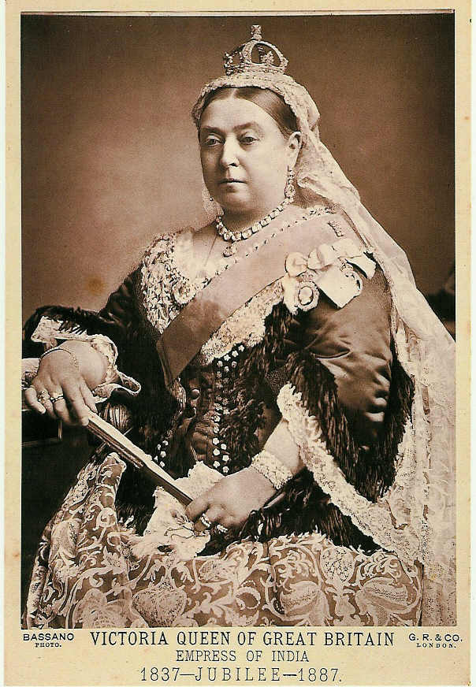
English Literature
Victorian Period
ruled by Queen
Victoria

Slide 54
Victorian Period
⇩
agricultural country England
⇩
manufacturing country
⇩
large cities with crowded slums grew up

Slide 55
large cities with crowded slums grew up

Slide 56
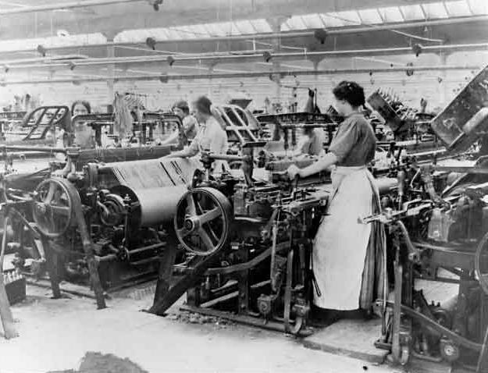
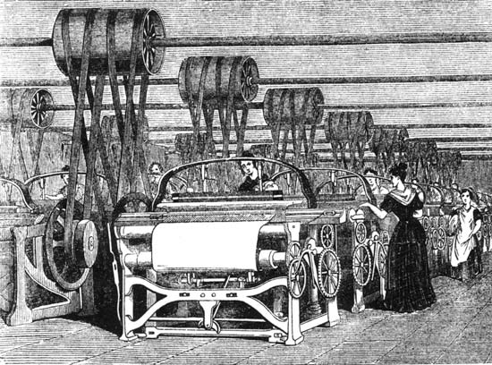
During Victorian Period, women workers had to work long hours with low paid.

Slide 57
Due to the Industrial Revolution, child labor was cruelly treated . Children had to work 12-18 hours a day.

Slide 58
The use of child labor in the factory

Slide 59
Victorian Period
⇩
poverty increase ⇨ conflicts between the poor and the rich
⇩
social protest of various kinds
⇩
expressed in literature

Slide 60
Prose
⇩
great increase in the quality and extent of
more prose writings
⇩
Age of Prose
⇩
simple, direct language of everyday speech unlike the literary language of the past

Slide 61
Novel
⇩
best-known literary genre

Charles Dickens
William Makepeace Thackeray
George Eliot
Thomas Hardy

Slide 62
Charles Dickens

Slide 63
Charles Dickens
⇩
used novels as a social force against unjust and cruel laws, school system, some institutions
⇩
portrayed the human life and characters realistically

Slide 64
Novels of Charles Dickens
⇩
Oliver Twist
David Copperfield
Bleak House
A Tale of Two Cities

Slide 65
Novel
William Makepeace Thackeray
⇩
attacked the hyprocrisy of English society

Vanity Fair

Slide 66
Novel
George Eliot
⇩
Mary Ann Evans
⇩
portrayed the life of small English communities
attacked the hypocrisy of English society

The Mill on the Floss
Silas Marner

Slide 67
Novel
Thomas Hardy
⇩
human beings are victims of enrironment or fate

Far from the Madding Crowd
The Mayor of Casterbridge
Tess of the D’Urbervilles

Slide 68
Novel during the late 19th-early 18th Century
⇩
many readers weary of moral restraints of
Victorian life
⇩
craved literature in which they could escape from the conventional and commonplace world around them
⇩
warmly welcomed fiction of Robert Louis Stevenson

Slide 69
Robert Louis Stenson

Romantic novels of adventure
⇩
used old themes of Romantic story-telling: shipwrecks, pirates, buried treasures
⇩
made them fresh, new and fascinating
⇩
made his characters real human beings, not the conventional good men and bad men, heroes and villains
of most romantic fiction

Slide 70
Robert Louis Stevenson

Treasure Island
Kidnapped
The Strange Case of Dr. Jekyll and Mr. Hyde

Slide 71
Robert Louis Stevenson’s Treasure Island

Slide 72
Poetry
⇩
dealt not only with nature and the past: the two stock themes of the romantic poems
⇩
the poets might be inspired by as astronomy, evolution, problems of capitalism and labor

Slide 73
Poetry
⇩
greatest Victorian poets
⇩
Robert Browning
Alfred, Lord Tennyson

Slide 74
Literature of the 19th Century
⇩
besides French and English literature
⇩
a huge literary output in other languages
were popular

Slide 75
Russian Literature

Slide 76
Russian Literature
⇩
Ivan Turgenev

collection of short stories
⇩
A Sportsman’s Sketches

Slide 77
Russian Literature
⇩
Anton Chekhov
⇩
famous for short stories

The Beggar
The Sea-Gull
Three Sisters

Slide 78
Russian Literature
⇩
Anton Chekhov
⇩
also famous for plays

The Cherry Orchard

Slide 79
Russian Literature
⇩
Leo Tolstoy
⇩
the most important Russian writer

War and Peace
Anna Karenina

Slide 80
Leo Tolstoy’s War and Peace

Slide 81
Poetry
⇩
Walt Whitman

Leaves of Grass
⇩
a free-flowing verse and lines of irregular length
⇩
to depict American democracy

Slide 82
Prose
⇩
novel
⇩
Mark Twain
(Samuel Langhorne Clemens)

Adventures of Tom Sawyor
Adventures of Huckleberry Finn

Slide 83
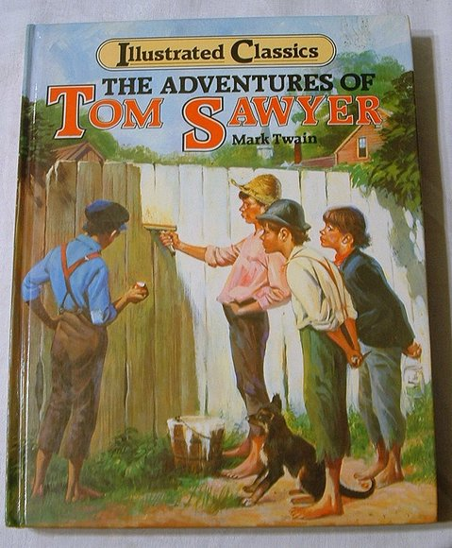

Slide 84
Prose
⇩
Naturalism
⇩
portrayed the misery and harsh conditions
of real life
⇩
every human being was determined by the forces of heredity and environment

Slide 85
Naturalistic Novelist
⇩
Stephen Crane
Theodore Dreiser

Slide 86
Naturalistic Novelist
⇩
Stephen Crane

A Red Badge of Courage

Slide 87
Naturalistic Novelist
⇩
Theodore Dreiser

An American Tragedy

